Slide 1
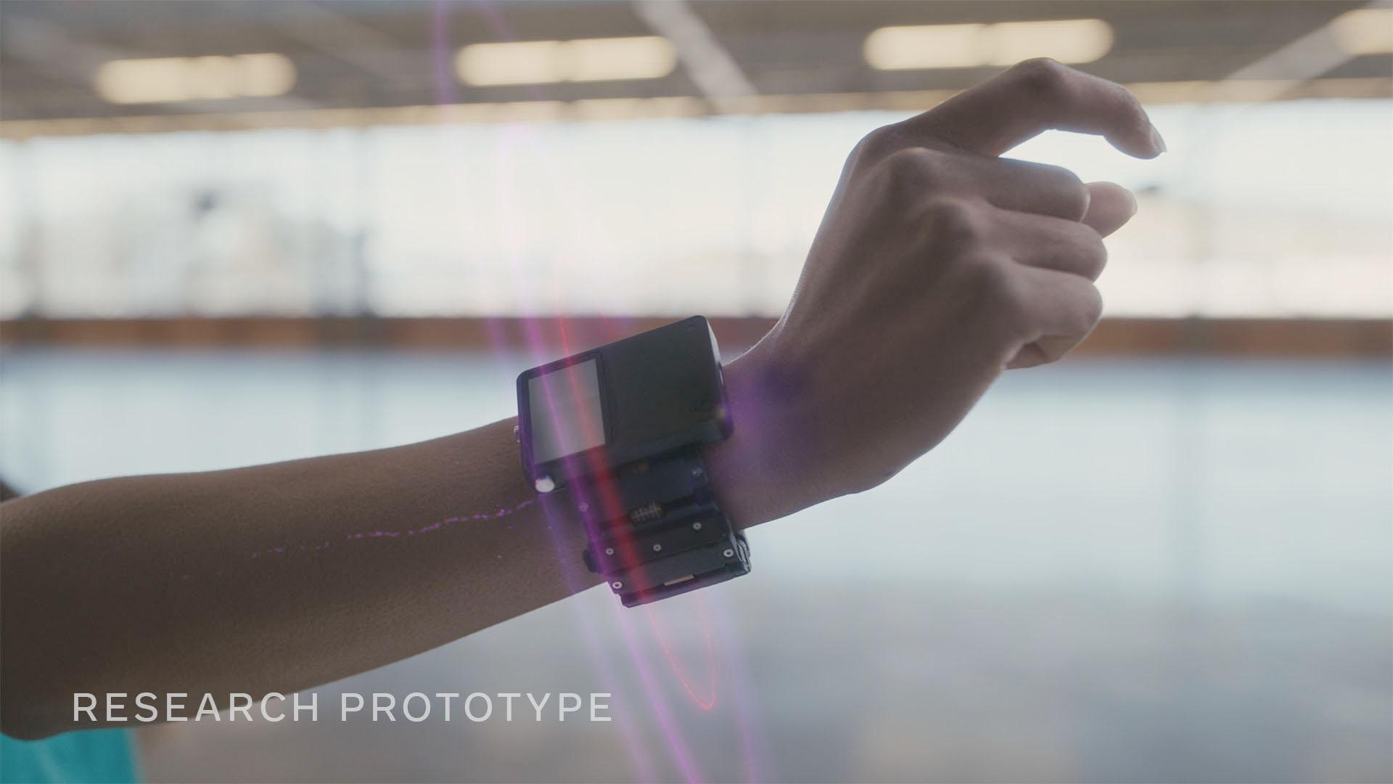
WRISTBAND TRY-ON
ENSC180

Slide 2
Group members
Fernando
ARIFD2001
Quang Minh Dinh
DINQD2003
Yoltic Alba
ALBYD1903

Slide 3
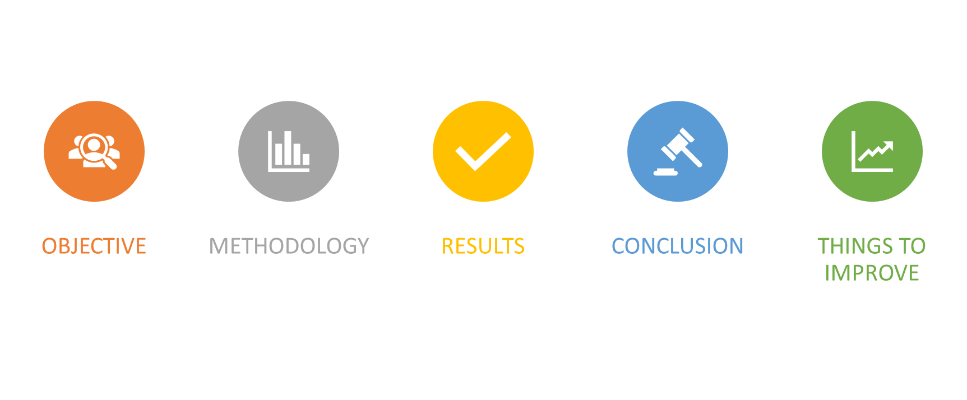
Introduction

Slide 4
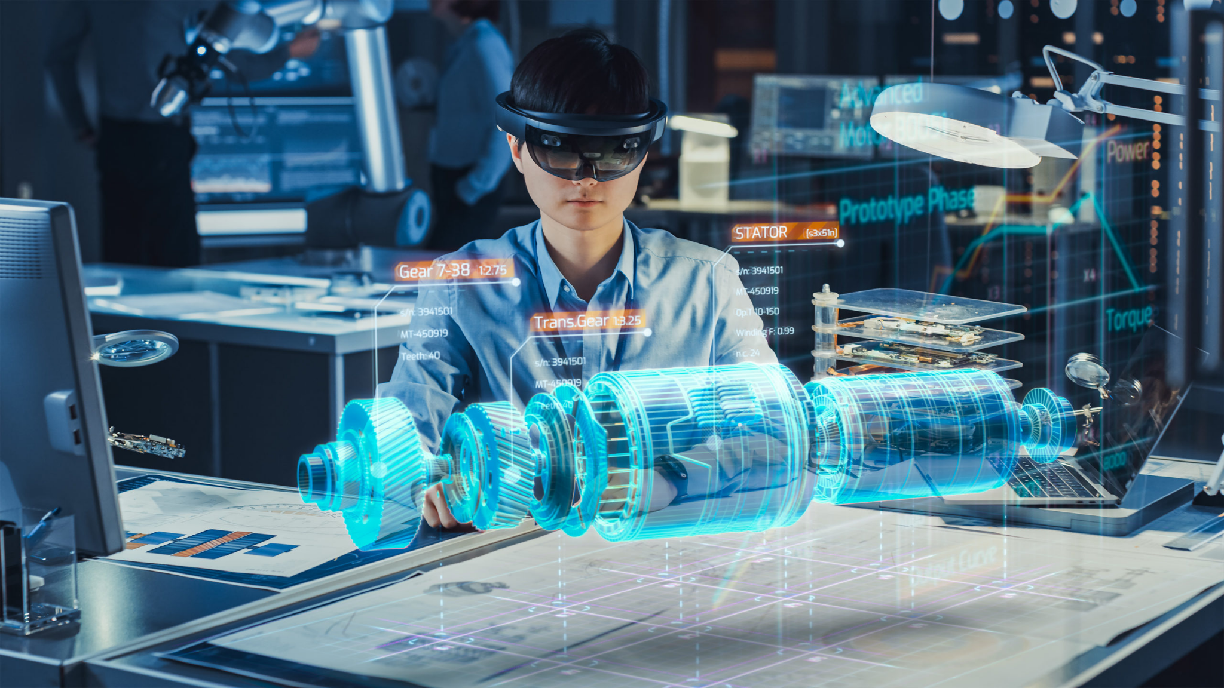
Background
Augmented reality
Research progress of hand landmarks localization

Slide 5
Objective
Create an app that helps the users to visualize how a wristband looks on their wrists.

Slide 6
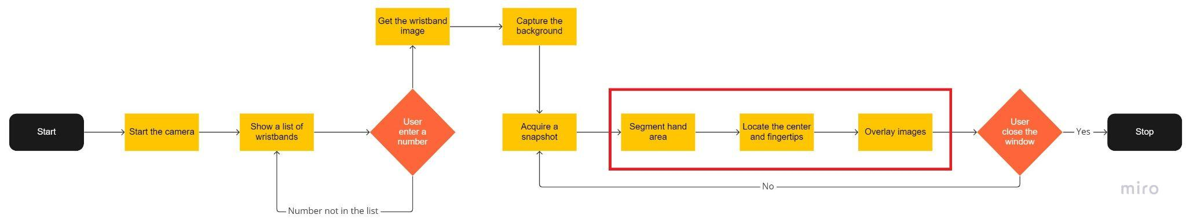
Methodology

Slide 7
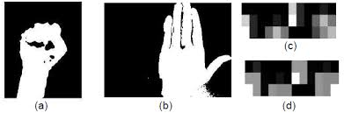
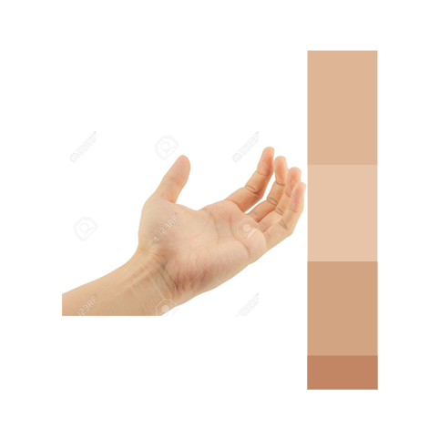
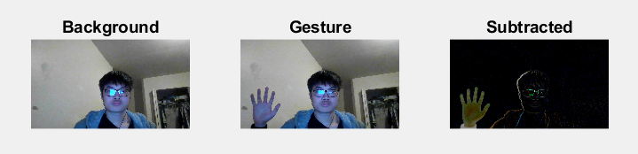
Hand Recognition
Viola-Jones (Haar Cascade) algorithm
HSV colours extraction
Background subtraction

Slide 8
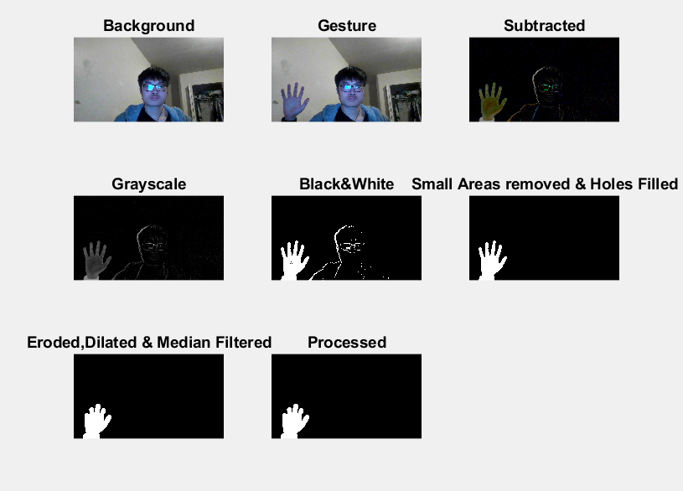
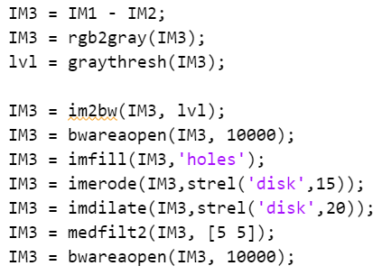
Hand Recognition

Slide 9
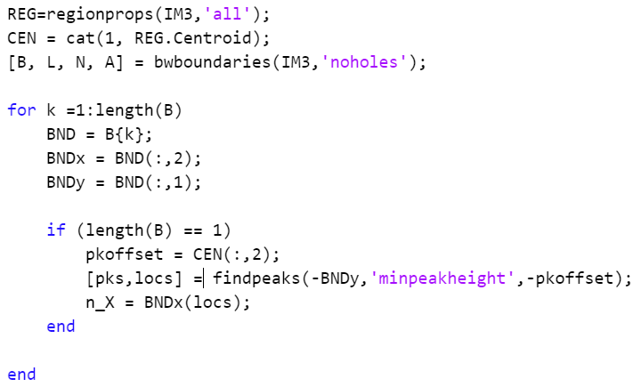
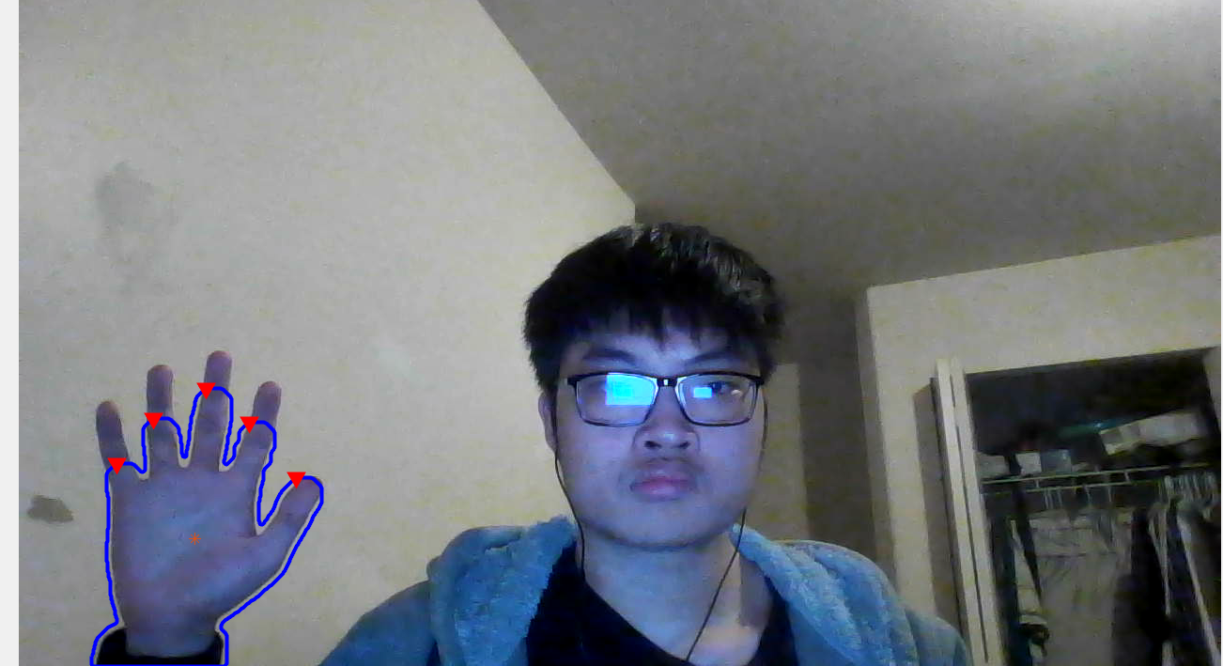
Hand Landmarks Localization

Slide 10
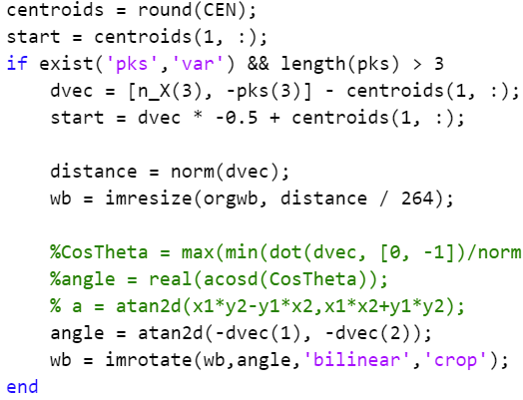

Images Overlaying
angle
distance
start

Slide 11
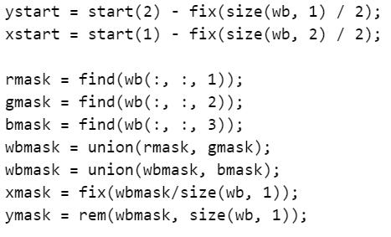
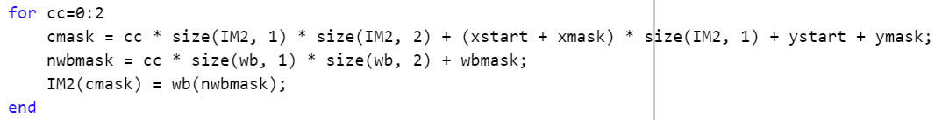
Images Overlaying

Slide 12
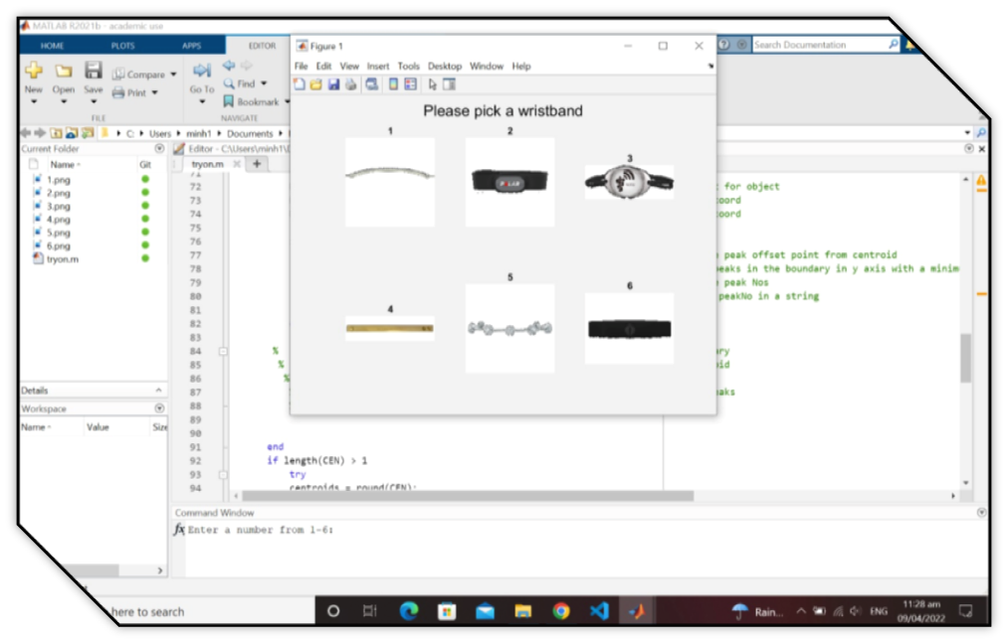
Results

Slide 13
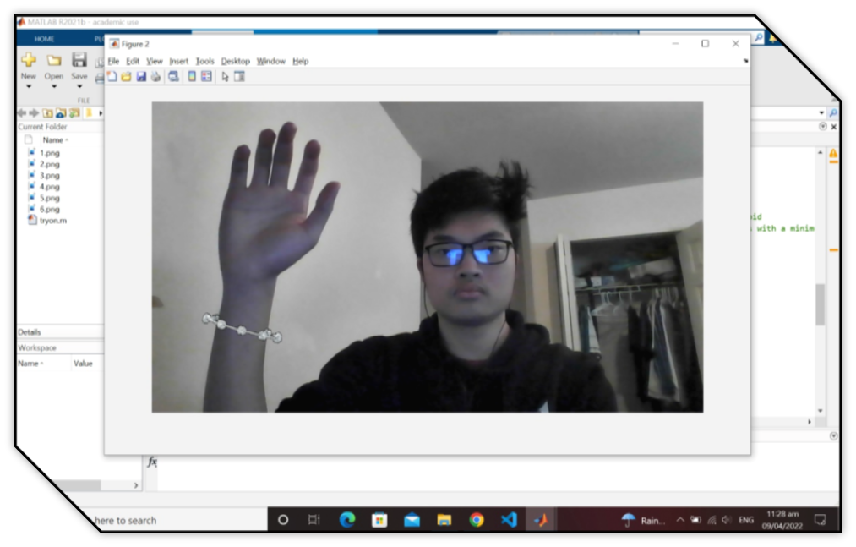
Results

Slide 14
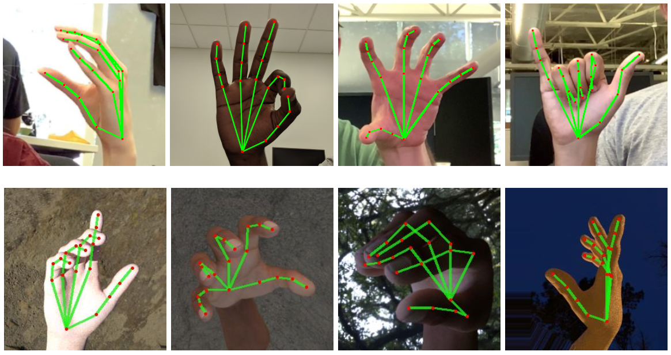
Recommendations and Conclusions

Slide 15
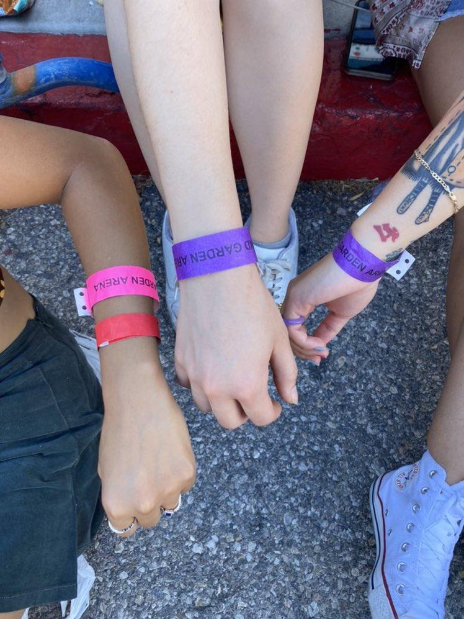
THANKS!
Do you have any questions?

